Slide 1
Was noch work in progress ist
Sorry
Paar Animationen sind unvollständig
Der History/Innovations/Area of application Teil ist unfertig/ausbaufähig
Im ALGOL Part fehlt zum running example eine Erklärung
Ansonsten Kleinigkeiten und Feinheiten

Slide 2
Historic Programming Languages
Fortgeschrittene Programmierkonzepte
Sandro, Toygun, Tufan

Slide 3
Konzept für ein Anfang folgt (willkürliche Bilder und Sprachen)

Slide 4
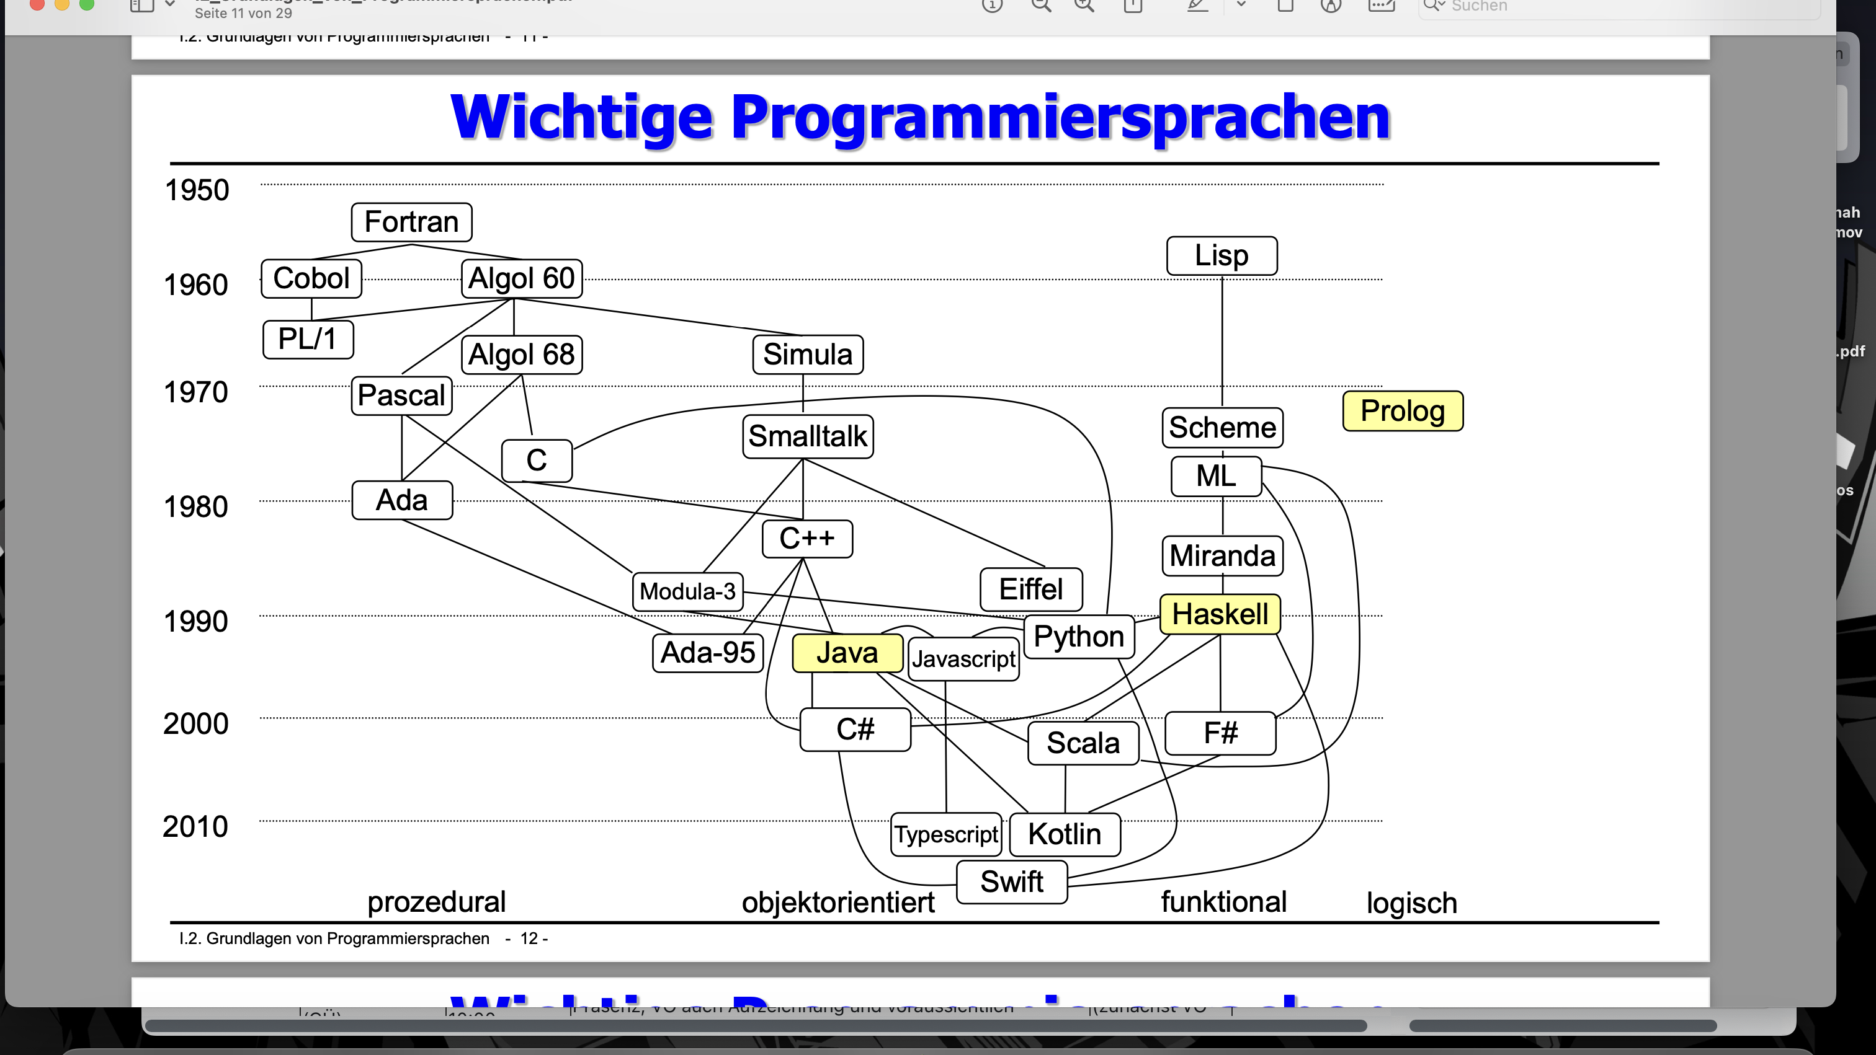
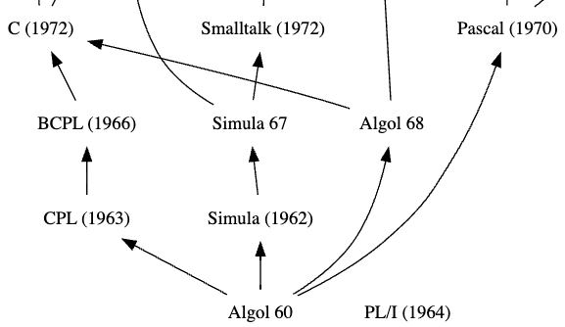

Slide 5
ALGOL
(algorithmic language)

Slide 6
ALGOL
What’s that?
ALGOL
ALGOL 58
ALGOL 68
First version of ALGOL
Numerical computing
Block structure
Much more complex
User- defined data types
ALGOL 60
More powerful
Flexible
Very influential
Recursion
Multi-dimensional arrays

Slide 7
ALGOL 60

Slide 8
ALGOL 60
History
ALGOL 60
Developed by an international comitee
Expressive and powerful
Simula (1962)
PL/1 (1964)
ALGOL 68
Pascal (1970)

Slide 9
ALGOL 60
Innovations
ALGOL 60
Recursion
Lexical scoping
Nested block structures
Semicolons as statement terminators
Clearer syntax, better to learn
Simula (1962)
PL/1 (1964)
ALGOL 68
Pascal (1970)

Slide 10
ALGOL 60
Areas of application
ALGOL 60
Algorithm development
Clear and concise
Scientific and engineering calculations
Simula (1962)
PL/1 (1964)
ALGOL 68
Pascal (1970)

Slide 11
Syntax

Slide 12
Code blocks
Syntax
begin
integer A, X;
real Z;
boolean Z;
Z := 2.5;
Code blocks defined with begin/end
Data types: integer, real, boolean
Operators: +, -, *, /, ÷, ↑
A := 5;
X := 8;
outinteger(1, A + X);
outinteger(1, A * X);
outinteger(1, Z / A);
outinteger(1, X ÷ A);
outinteger(1, X ↑ A);
end
Output: 8
40
0.5
1
32768

Slide 13
Lexical Scoping
Syntax
begin
integer A, X;
A := 5;
Scope of variable determined by position in code/which block
Can be accessed within block and any block nested within
Incorporated in Java, Python, JavaScript
X := 8;
comment outer X;
begin
integer X, Y;
X := 5;
comment inner X assigned here;
Y := 10;
end
outinteger(1,X);
Y := 12;
comment error! Y not defined in outer scope;
end
Output: 8

Slide 14
Arrays
Syntax
begin
procedure arrayproc(n); value n; integer n;
begin
Every array declared with one data type
real array by default
array[start:end]
integer array x[0:n-1];
x[0]:=10;
x[1]:=11;
x[2]:=12;
x[3]:=13;
≠ Java
outstring(1,“Value at index 2: ");
outinteger(1,x[2]);
end
integer n := 4;
arrayproc(n)
end
Output: Value at index 2: 12

Slide 15
Control structures
Syntax
If-then-else
For loops
integer i, j;
integer i, j;
i := 1;
FOR i:=1 STEP 1 UNTIL 5 DO
j := 8;
begin
IF i=1 THEN outinteger(1,“I“);
FOR J:=1 STEP 1 UNTIL i DO
outstring(1,“ * ");
IF i<j THEN outstring(1,“I<j“)
end
ELSE outstring(1,“i>=j“);
Output: *
**
***
****
*****
Output: 1 i<j

Slide 16
Running example

Slide 17
Example
Running example
begin
procedure circleAreaProblem(radius,area); real area; radius;
Text folgt
real pi := 3.14159;
begin
real circleArea := pi * radius * radius;
if circleArea <= area then
outstring(1, "The circle can be painted“)
else
outstring(1, "The circle cannot be painted“)
end
circleAreaProblem(5, 75);
end
Output: The circle cannot be painted

Slide 18
What did ALGOL do 60 good?

Slide 19
Goods
ALGOL 60
It has recursion
Block structure
Lexical scoping
Clean and consistent syntax
Used in modern languages like Java

Slide 20
Bads
ALGOL 60
No build in I/O facilities
Limited set of data types
No object-oriented programming
Lack of standardization
Hard to write with complex data structures
Less suited for large scale programms

Slide 21
Conclusion

Slide 22
Conclusion
ALGOL 60
Goods
Bads
Legacy Language
It has recursion
Block structure
Lexical scoping
Clean and consistent syntax
No build in I/O facilities
Limited set of data types
No object-oriented programming

